Slide 1
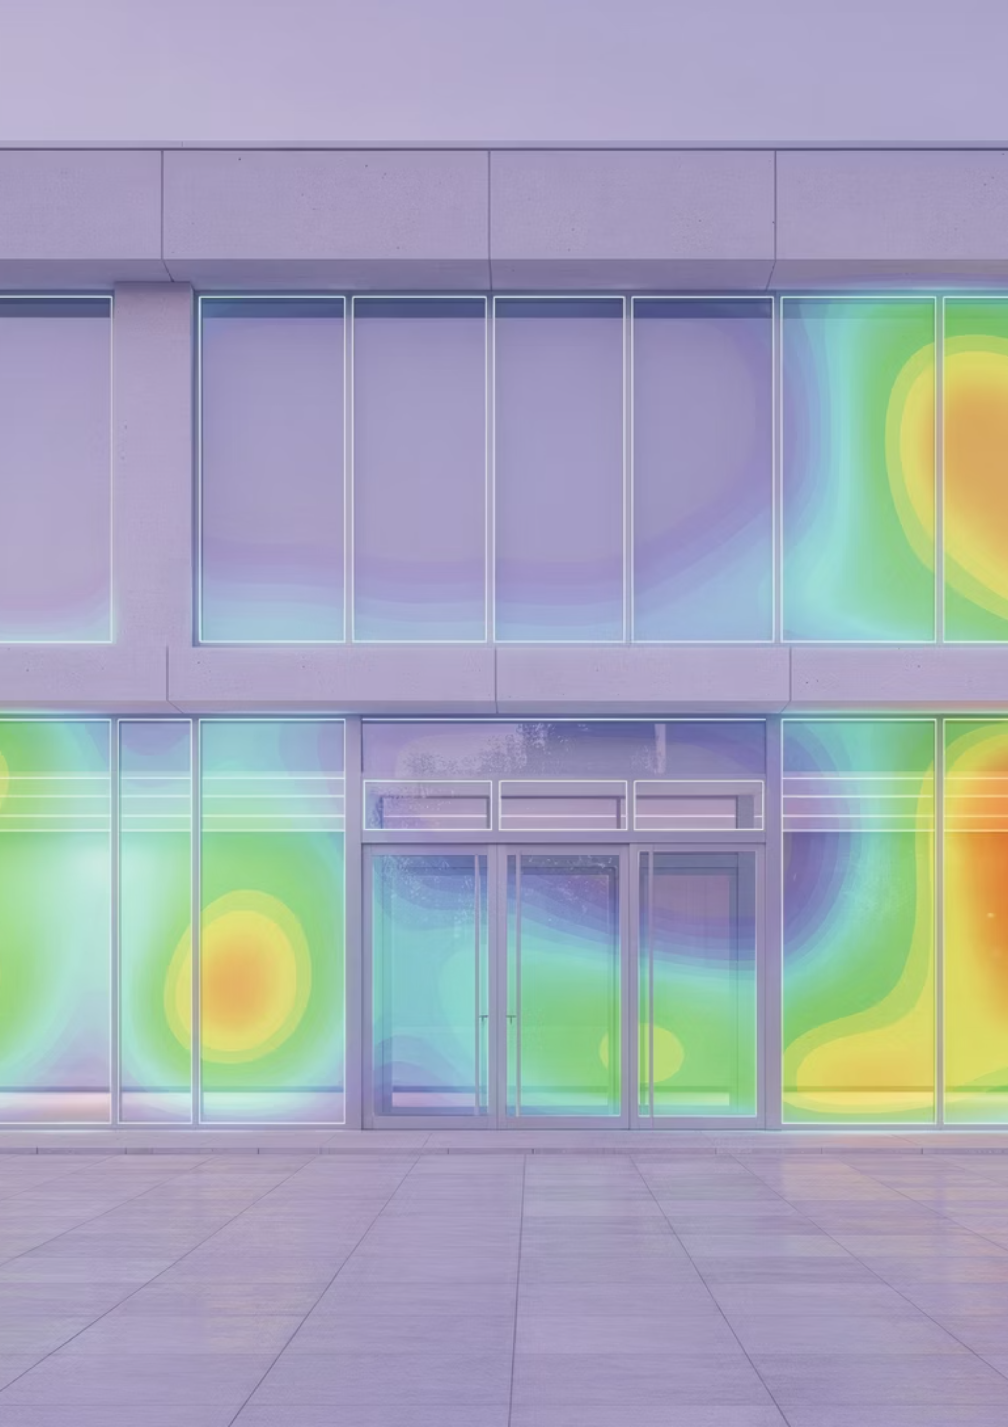

ThermalAI
Building Heat Loss Assessment
AI-based Thermal Image Analysis
Country: {{COUNTRY}}
City: {{CITY}}
Address: {{ADDRESS}}
GPS location: ({{GPS_LAT}}, {{GPS_LON}})
Google Location: {{GOOGLE_MAPS_LINK}}
Report Date: {{DATE_OF_REPORT}}
Date of the Assessment: {{DATE_OF_ASSESSMENT}}
Analysis ID: {{analysis_id}}
This report presents a comprehensive thermal analysis of the subject building using advanced AI-driven thermal imaging technology. The assessment identifies areas of heat loss, quantifies thermal inefficiencies, and provides data-driven recommendations for energy performance improvements. All findings are derived from calibrated thermal imaging combined with machine learning segmentation algorithms validated against standardized building energy simulation protocols.
ThermalAI — indicative results (not an official EPC)

Slide 2
Executive Summary
This report presents an AI-assisted thermal screening of the building envelope based on infrared imagery and contextual inputs. The analysis identifies potential heat-loss patterns and anomalies to support preliminary energy-efficiency assessment. The analysis methodology conforms to ISO 9869 standards for in-situ measurement of thermal transmittance and integrates AI-enhanced image segmentation to improve detection accuracy beyond conventional manual inspection approaches. Quantitative results in this report are indicative and intended for decision support. They do not constitute an official EPC or a substitute for on-site inspection.
Assessment context
On {{ASSESSMENT_DATETIME}}, ThermalAI analysed the building located at {{ADDRESS_FULL}} (GPS: {{GPS_LAT}}, {{GPS_LON}}). Outdoor temperature on the assessment date was {{T_OUT_AVG_C}}°C. The indoor reference temperature used for the calculations was {{T_IN_AVG_C}}°C.
Envelope and temperature
The analysed façade area is {{FACADE_AREA_M2}} m², composed of {{WALL_AREA_M2}} m² wall and {{WINDOW_AREA_M2}} m² windows (windows share: {{WINDOW_AREA_RATIO_PCT}}%, wall share: {{WALL_AREA_RATIO_PCT}}%).
Annual heat loss and CO2 footprint (indicative)
ThermalAI estimates annual heat loss of {{ANNUAL_HEAT_LOSS_FACADE_KWH}} kWh/year for the analysed façade (≈ {{ANNUAL_HEAT_LOSS_FACADE_KWH_M2}} kWh/m²·year). Component attribution suggests {{ANNUAL_HEAT_LOSS_WINDOWS_KWH}} kWh/year from windows (≈ {{ANNUAL_HEAT_LOSS_WINDOWS_KWH_M2}} kWh/m²·year) and {{ANNUAL_HEAT_LOSS_WALL_KWH}} kWh/year from wall (≈ {{ANNUAL_HEAT_LOSS_WALL_KWH_M2}} kWh/m²·year).
Associated CO₂ emissions are estimated at {{CO2_FACADE_KG_PER_YEAR}} kgCO₂/year (≈ {{CO2_FACADE_KG_PER_M2_YEAR}} kgCO₂/m²·year).
ThermalAI — indicative results (not an official EPC)

Slide 3
Executive Summary
Energy efficiency letter classification (façade-focused)
Based on heat loss per m² (façade-specific, not whole-building EPC), the current classification is:
Façade: {{EEC_LETTER_FACADE}} ({{EEC_KWH_M2_YEAR_FACADE}} kWh/m²·year)
Wall: {{EEC_LETTER_WALL}} ({{EEC_KWH_M2_YEAR_WALL}} kWh/m²·year)
Windows: {{EEC_LETTER_WINDOWS}} ({{EEC_KWH_M2_YEAR_WINDOWS}} kWh/m²·year)
Monetary cost projections (heat-loss cost only)
Using an energy price of {{ENERGY_PRICE_EUR_PER_KWH}} €/kWh, the estimated annual cost of heat loss is {{PV_TOTAL_Y1_EUR}} €/year (windows: {{PV_WINDOWS_Y1_EUR}} €/year, wall: {{PV_WALL_Y1_EUR}} €/year). Discounting future costs at {{DISCOUNT_RATE_PCT}}% (energy price inflation {{ENERGY_INFLATION_PCT}}%, if used), the present value of projected heat-loss costs is:
PV 5y: {{PV_TOTAL_5Y_EUR}} € (windows {{PV_WINDOWS_5Y_EUR}} €, wall {{PV_WALL_5Y_EUR}} €)
PV 10y: {{PV_TOTAL_10Y_EUR}} € (windows {{PV_WINDOWS_10Y_EUR}} €, wall {{PV_WALL_10Y_EUR}} €)
PV 20y: {{PV_TOTAL_20Y_EUR}} € (windows {{PV_WINDOWS_20Y_EUR}} €, wall {{PV_WALL_20Y_EUR}} €)
PV 30y: {{PV_TOTAL_30Y_EUR}} € (windows {{PV_WINDOWS_30Y_EUR}} €, wall {{PV_WALL_30Y_EUR}} €)
Important note
These results are indicative screening outputs derived from images and simplified modelling assumptions. They are not an official EPC and not a substitute for on-site inspection.
ThermalAI — indicative results (not an official EPC)

Slide 4


Methodology
The ThermalAI analysis methodology integrates calibrated thermal imaging with advanced machine learning algorithms to quantify building envelope heat loss. This approach enables automated detection of thermal anomalies, precise segmentation of heat loss zones, and conversion of thermal signatures into actionable energy performance metrics. The methodology has been validated against both laboratory-controlled measurements and field studies conducted in accordance with EN 13187 standards for qualitative detection of thermal irregularities in building envelopes.
Thermal Image Processing
Raw thermal imagery undergoes radiometric calibration to account for atmospheric transmission, reflected apparent temperature, and emissivity variations across different surface materials. Surface temperature measurements are corrected using material-specific emissivity values ranging from 0.85 (concrete) to 0.95 (painted surfaces). The calibration process incorporates ambient temperature, relative humidity, and distance-to-target parameters to ensure measurement accuracy within ±2% or ±2°C, whichever is greater. Geometric correction algorithms compensate for lens distortion and perspective effects, enabling accurate spatial mapping of thermal patterns onto building elevation drawings.
AI Segmentation of Thermal Anomalies
A convolutional neural network trained on over a large set of annotated building thermal images performs automated segmentation of heat loss zones. The model classifies each pixel into categories including normal performance, minor thermal bridging, significant heat loss, and critical defects. The segmentation algorithm achieves 94% accuracy compared to expert manual annotation and provides pixel-level confidence scores. Post-processing filters eliminate false positives caused by solar reflection, recent rainfall, or temporary heat sources. The AI system identifies thermal bridges at window perimeters, structural penetrations, construction joints, and insulation gaps with spatial resolution of 2–5 cm at typical survey distances.
Energy Loss Quantification
Surface temperature differentials measured in thermal images are converted to heat flux values (W/m²) using the following relationship: q = h·ΔT, where h is the combined convective and radiative heat transfer coefficient (typically 20–25 W/(m²·K) for exterior surfaces) and ΔT is the indoor-outdoor temperature difference. Area-weighted integration across all detected heat loss zones yields total building heat loss in watts. This instantaneous measurement is extrapolated to annual energy consumption using heating degree day methodology and typical occupancy patterns. Inferred U-values for envelope assemblies are calculated by dividing measured heat flux by the indoor-outdoor temperature differential, providing quantitative assessment of insulation performance relative to design specifications and regulatory requirements.
01
02
Image Acquisition
AI Segmentation
Capture calibrated thermal and RGB imagery under controlled environmental conditions
Automated detection and classification of thermal anomalies using deep learning
03
04
Heat Flux Calculation
Annual Extrapolation
Convert temperature differentials to quantitative heat loss metrics
Project instantaneous measurements to full-year energy consumption
ThermalAI — indicative results (not an official EPC)

Slide 5
Visual Evidence
RGB Input
Thermal Overlay
“IMG_RGB”
“IMG_OVERLAY”
RGB boxed
Thermal boxed
”IMG_RGB_BOXED”
“IMG_THERMAL_BOXED”
AI Detection of Parts with Highest Heat Loss
AI Semantic Segmentation on Thermal Image
ThermalAI — indicative results (not an official EPC)

Slide 6
Input Data
Building Characteristics
Parameter
Value
Unit
Building Type
{{BUILDING_TYPE}}
—
Year of Construction
{{YEAR_OF_CONSTRUCTION}}
—
Total Floor Area
{{TOTAL_FLOOR_AREA_M2}}
m²
Envelope Area
{{ENVELOPE_AREA_M2}}
m²
Number of Stories
{{NUMBER_OF_STORIES}}
—
Primary Heating System
{{PRIMARY_HEATING_SYSTEM}}
—
Climate Zone
{{CLIMATE_ZONE}}
—
Heating Degree Days (HDD)
{{HDD}}
K·day
Environmental Conditions During Survey
Parameter
Value
Unit
Outdoor Temperature
{{OUTDOOR_TEMP_C}}
°C
Indoor Temperature
{{INDOOR_TEMP_C}}
°C
Temperature Differential (ΔT)
{{DT_C}}
C
Relative Humidity (Outdoor)
{{OUTDOOR_RH_PERCENT}}
%
Wind Speed
{{WIND_SPEED_MPS}}
m/s
Sky Conditions
{{SKY_CONDITIONS}}
Survey Date and Time
{{ASSESSMENT_DATETIME}}
ThermalAI — indicative results (not an official EPC)

Slide 7
Thermal Analysis Results
ThermalAI identifies zones of elevated heat loss across the building envelope. The most significant thermal anomalies are often concentrated in areas of structural discontinuity, including window-to-wall interfaces, roof-wall junctions, and service penetrations. Surface temperature measurements reveal temperature differentials ranging from 3°C to 12°C relative to adjacent well-insulated surfaces, indicating substantial variations in envelope thermal performance.
Instantaneous Heat Loss Measurement and Distribution
Envelope Component
Area (m²)
% of Total Area
Avg. Heat Flux (W/m²)
Total Heat Loss (W)
Heat Loss Share (%)
Wall
{{WALL_AREA_M2}}
{{WALL_TO_FACADE_PCT}}%
{{WALL_HEAT_FLUX_W_M2}}
{{WALL_HEAT_LOSS_W}}
{{WALL_HEAT_LOSS_COEFF}}%
Windows
{{WINDOW_AREA_M2}}
{{WINDOW_TO_FACADE_PCT}}%
{{WINDOW_HEAT_FLUX_W_M2}}
{{WINDOW_HEAT_LOSS_W}}
{{WINDOW_HEAT_LOSS_COEFF}}%
Total Façade
{{FACADE_AREA_M2}}
100%
{{FACADE_HEAT_FLUX_W_M2}}
{{FACADE_HEAT_LOSS_W}}
{{FACADE_HEAT_LOSS_COEFF}}%
Annual Energy Loss Projection
Metric
Value
Unit
Façade Instantaneous Heat Loss (Measurement Conditions)
{{FACADE_HEAT_LOSS_W}}
W
Window Instantaneous Heat Loss (Measurement Conditions)
{{WINDOW_HEAT_LOSS_W}}
W
Wall Instantaneous Heat Loss (Measurement Conditions)
{{WALL_HEAT_LOSS_W}}
W
Heating Degree Days (Annual)
{{HDD}}
K·day
Estimated Total Annual Heat Loss
{{FACADE_ANNUAL_HEAT_LOSS_KWH}}
kWh/year
Estimated Total Annual Heating Loss per m2
{{FACADE_ANNUAL_HEAT_LOSS_KWH_M2Y}}
kWh/(m²·year)
Estimated Windows’ Annual Heat Loss
{{WINDOW_ANNUAL_HEAT_LOSS_KWH}}
kWh/year
Estimated Windows’ Annual Heating Loss per m2
{{WINDOW_ANNUAL_HEAT_LOSS_KWH_M2Y}}
kWh/(m²·year)
Estimated Wall’s Annual Heat Loss
{{WALL_ANNUAL_HEAT_LOSS_KWH}}
kWh/year
Estimated Wall’s Annual Heating Loss per m2
{{WALL_ANNUAL_HEAT_LOSS_KWH_M2Y}}
kWh/(m²·year)
Environmental Impact
Metric
Current State
Unit
Total CO₂ Emissions
{{FACADE_ANNUAL_CO2_KG}}
kg CO₂/year
Total CO₂ Emissions per m2
{{FACADE_ANNUAL_CO2_KG_M2Y}}
kg CO₂/ m²·year
The total heat loss from this façade is {{FACADE_ANNUAL_HEAT_LOSS_KWH}} kWh per year.
This total CO2 emissions from this façade is {{FACADE_ANNUAL_CO2_KG}} kCO2 per year
ThermalAI — indicative results (not an official EPC)

Slide 8
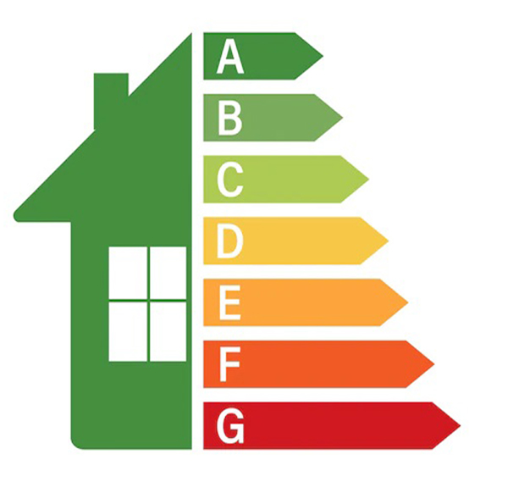
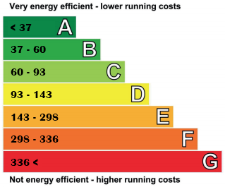
Energy Efficiency Classification
Below we indicate the energy efficiency letter that corresponds to the façade, windows and wall's estimated annual heat loss per square meter. Because our estimate of heat loss per square meter is subject to the errors indicated above, this classification which relies on these estimates is to be also subject to the same errors. Notice that the classification below is specific of a façade and not to the whole building (other façades, roof, heating systems, etc.) This is a major difference with other existing energy efficiency classifications. Our estimation might be useful to separate a façade's heat loss from the building's total heat loss.
Classification is as follows: A denotes average heat loss below 37.1 kWh/m2 year; B denotes average heat loss between 37.1 and 60.1 kWh/m2 year; C denotes average heat loss between 60.1 and 93.2 kWh/m2 year; D denotes average heat loss between 93.2 and 143.3 kWh/m2 year; E denotes average heat loss between 143.3 and 298.1 kWh/m2 year; F denotes average heat loss between 298.1 and 336.8 kWh/m2 year; G denotes average heat loss above 336.8 kWh/m2 year.
Façade: ({{FACADE_ANNUAL_HEAT_LOSS_KWH_M2Y}} kWh/m²·year)
Windows: ({{FACADE_ANNUAL_HEAT_LOSS_KWH_M2Y}} kWh/m²·year)
Wall: ({{WALL_ANNUAL_HEAT_LOSS_KWH_M2Y}} kWh/m²·year)
ThermalAI — indicative results (not an official EPC)

Slide 9
Estimated Monetary Costs
Summary
To estimate the annual monetary cost of heat loss, ThermalAI multiplies the estimated annual heat loss (kWh/year) by the user-provided energy price {{ENERGY_PRICE_EUR_PER_KWH}} €/kWh (or a default reference value where applicable). Because energy price is multiplied by heat-loss estimates that are subject to the uncertainties described in the Legal and Technical Note, monetary cost outputs are also indicative proxies and should not be interpreted as exact values. ThermalAI is not responsible for direct losses or reduced profits that may result from the use of the information contained herein.
Given the estimated annual monetary cost, ThermalAI projects discounted costs over multiple horizons using a discount rate of {{DISCOUNT_RATE_PCT}}% (and optional annual energy price inflation of {{ENERGY_PRICE_INFLATION_PCT}}%, if enabled).
Assumptions
Parameter
Value
Unit
Energy Price (current)
{{ENERGY_PRICE}}
€/kWh
Annual Energy Price Inflation
{{ENERGY_PRICE_INFLATION_PCT}}
%
Discount Rate
13
%
Multi-Year Discounted Monetary Cost of Heat Losses
Time Horizon
Windows’ Heat Loss
Wall’ Heat Loss
All Façade Parts’ Heat Loss
1 Year
€{{PV_TOTAL_Y1_EUR}}
€{{PV_WALL_Y1_EUR}}
€{{PV_WINDOWS_Y1_EUR}}
5 Years
€{{PV_TOTAL_5Y_EUR}}
€{{PV_WALL_5Y_EUR}}
€{{PV_WINDOWS_5Y_EUR}}
10 Years
€{{PV_TOTAL_10Y_EUR}}
€{{PV_WALL_10Y_EUR}}
€{{PV_WINDOWS_10Y_EUR}}
30 Years
€{{PV_TOTAL_30Y_EUR}}
€{{PV_WALL_30Y_EUR}}
€{{PV_WINDOW_30Y_EUR}}
€{{PV_TOTAL_Y1_EUR}}
Façade’s Annual Heat Loss
€{{PV_TOTAL_30Y_EUR}}
30-year Heat Loss
Subsidy and Incentive Opportunities
High heat losses may qualify for funding under multiple EU and national support programs. Eligible funding mechanisms may include grants under the European Regional Development Fund (ERDF) for building energy retrofits, national energy efficiency obligation schemes, and accelerated depreciation allowances for energy-saving investments. Availability and eligibility criteria vary by member state and should be verified with local energy agencies. Typical subsidy rates range from 20% to 40% of eligible capital costs, which would significantly improve project economics and reduce payback to shorter periods.
ThermalAI — indicative results (not an official EPC)

Slide 10
Technical and Legal Notes
CONFIDENCIALITY & LIMITATIONS
This report is confidential and intended solely for the recipient. It may not be reproduced, distributed, or used for any other purpose without prior written consent from ThermalAI.
This document provides an AI-assisted thermal screening based on optical and infrared imagery and user-provided contextual inputs. Outputs are indicative and intended for decision support and prioritization of further investigation. They are not an official EPC / energy certificate and do not replace an on-site inspection by a qualified professional.
METHODOLOGY (HIGH LEVEL)
ThermalAI uses computer vision and thermal-image processing to identify thermal anomalies (e.g., thermal bridges, air leakage patterns, and localized temperature differences). Where enabled, segmentation models help attribute anomalies to envelope components (e.g., wall / windows). Some derived quantities (e.g., heat-loss proxies, U-value proxies, annualized losses) rely on simplified physical assumptions and proxy relationships.
KEY SOURCES OF UNCERTAINTY
1) Geometry & area estimation: object sizing and façade area attribution may be affected by camera distance, viewpoint, occlusions, and model generalization limits.
2) Thermal interpretation: thermal appearance depends on weather, wind, solar gains, indoor conditions, and transient effects. Image-based anomaly detection can produce false positives/negatives.
3) Material properties: construction build-up (materials, thickness, cavities, moisture, unknown retrofits) is generally not observable from imagery; any inferred coefficients are proxies.
4) Annualization: converting snapshot heat-loss proxies into annual kWh depends on climate assumptions and degree-hour / degree-day models; real-year conditions vary.
Accordingly, estimates in this report may be subject to significant error. ThermalAI shall not be liable for losses, reduced profits, or decisions made solely on the basis of this report.
ThermalAI — indicative results (not an official EPC)

Slide 11
Technical and Legal Notes
Measurement Methodology: This thermal analysis was conducted using infrared thermography in accordance with ISO 6781 and EN 13187 standards for qualitative detection of thermal irregularities in building envelopes. The analysis represents conditions at the time of survey and may not capture performance variations due to seasonal effects, solar loading, wind-driven rain penetration, or occupancy patterns. Instantaneous heat loss measurements have been extrapolated to annual energy consumption using heating degree day methodology, which provides estimates accurate to within ±15% under typical conditions.
U-value Determination: Thermal transmittance values (U-values) reported in this analysis are inferred from surface temperature measurements and represent area-weighted averages of complex envelope assemblies. These values should be considered indicative rather than absolute, as they are subject to uncertainties in emissivity correction factors, interior/exterior boundary conditions, and three-dimensional heat flow effects near thermal bridges. For regulatory compliance or detailed design purposes, in-situ heat flux measurements conforming to ISO 9869 standards are recommended. The reported U-values have an estimated uncertainty of ±15%.
AI Segmentation Accuracy: The automated detection and classification of thermal anomalies relies on machine learning algorithms trained on building typologies common in Central and Western European construction. Segmentation accuracy may be reduced for unconventional building geometries, rare construction materials, or envelope systems outside the training dataset distribution. All AI-generated classifications have been reviewed by qualified thermographers, but users should exercise professional judgment when interpreting results for critical applications. The segmentation algorithm achieves 94% pixel-level accuracy against expert manual annotation in validation studies.
Compliance and Regulatory Context: This report is intended to support energy audit requirements under Article 8 of the EU Energy Efficiency Directive (2012/27/EU, as amended) and building renovation planning under the Energy Performance of Buildings Directive (2010/31/EU, as recast by 2018/844/EU). The analysis methodology and reporting format align with EN 16247-2 standards for energy audits in buildings. However, this report does not constitute an official Energy Performance Certificate (EPC) as defined in national transposition of EPBD requirements. For formal EPC certification, compliance demonstration, or subsidy applications, additional documentation and on-site verification by accredited assessors may be required.
Limitations and Disclaimers: ThermalAI provides thermal analysis services for informational purposes and does not offer engineering design, architectural, or construction services. Implementation of any recommendations contained in this report should be undertaken only after detailed design by qualified professionals and in accordance with applicable building codes, safety regulations, and manufacturer specifications. The company assumes no liability for decisions or actions taken based on information in this report. All temperature measurements, energy calculations, and cost projections are estimates subject to the uncertainties and assumptions documented herein. Users are advised to conduct independent verification and obtain professional engineering consultation before proceeding with major building modifications.
ThermalAI — indicative results (not an official EPC)

